Slide 1
Zomato Project
Exploratory Data Analysis (EDA) Using Python
Presented by
Komala
B.Tech Computer Science & Engineering

Slide 2
Project Overview
Objective
Analyze the Zomato restaurant dataset.
Understand restaurant pricing, cuisines, timings, customer ratings, and reviews.
Generate business insights using Python.
Tools Used
Python
Pandas
NumPy
Matplotlib
Jupyter Notebook

Slide 3
Dataset Information
Dataset Details
Dataset 1: Restaurant Metadata
Restaurant Name
Cost
Cuisines
Timings
Collections
Dataset 2: Restaurant Reviews
Reviewer
Review
Rating
Time
Pictures

Slide 4
Data Cleaning
Data Cleaning Process
Checked the dataset dimensions using shape().
Examined data types using info().
Generated statistical summaries using describe().
Identified missing values using isnull().sum().
Removed duplicate records using drop_duplicates().
Verified the cleaned dataset before analysis.
Why Data Cleaning?
Improves data quality.
Removes duplicate records.
Ensures accurate analysis and visualization.

Slide 5
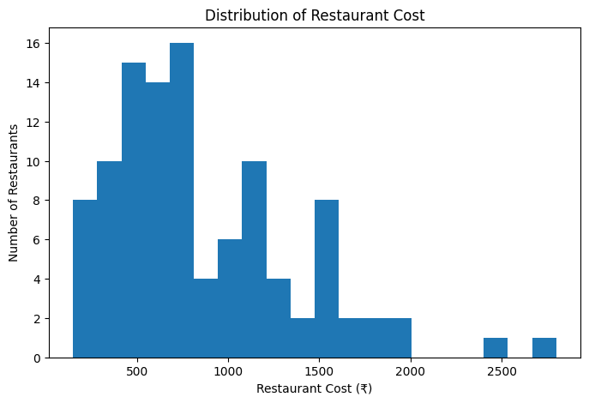
Restaurant Cost Analysis
Key Findings
Most restaurant costs range between ₹300 and ₹800.
The number of restaurants decreases as the cost increases.
Only a few restaurants cost more than ₹2000.
The dataset mainly consists of affordable and moderately priced restaurants.
Observation
Most restaurants are affordable or moderately priced, while premium restaurants are relatively few.

Slide 6
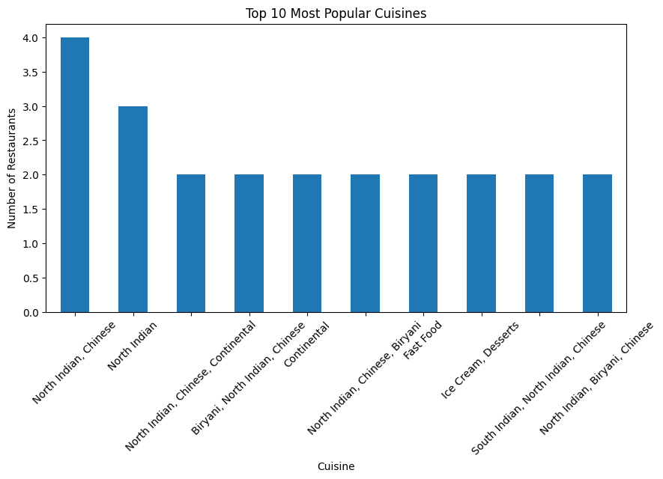
Cuisine & Timings Analysis
Observation
North Indian and Chinese cuisine is the most common.
North Indian cuisine is also highly popular.

Slide 7
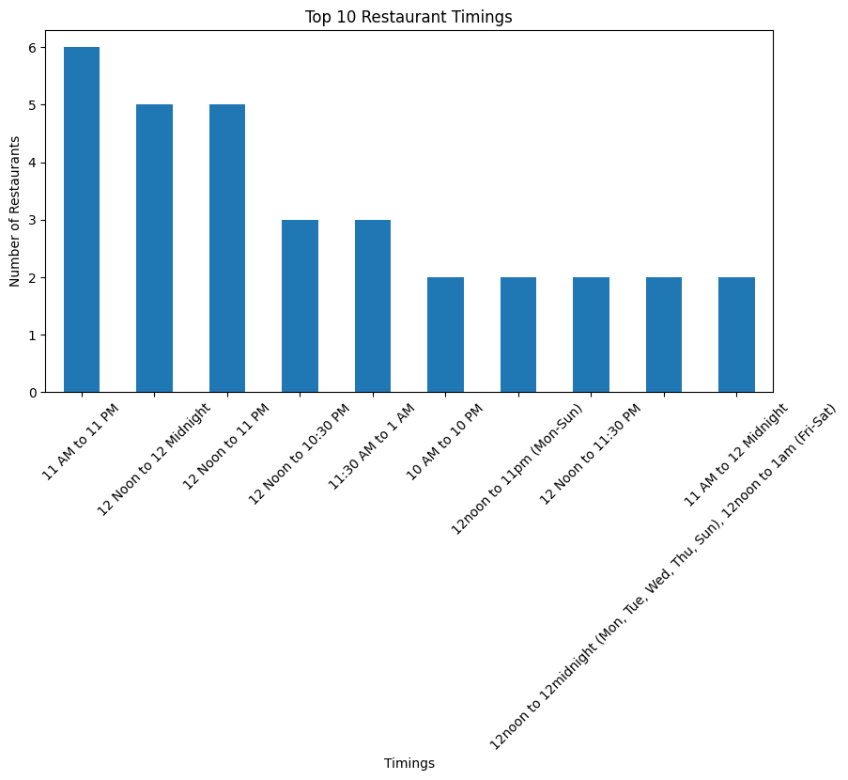
Customer Ratings & Review Length Analysis
Key Findings
Most customers gave 5-star ratings.
4-star ratings are the second most common.
Very few customers gave 1-star or 2-star ratings.
This indicates a high level of customer satisfaction.

Slide 8
Conclusion
Conclusion
Successfully analyzed the Zomato restaurant dataset using Python.
Cleaned the data by removing duplicates and checking missing values.
Most restaurants are affordable and moderately priced.
North Indian and Chinese cuisines are the most popular.
Most restaurants operate from 11 AM to 11 PM.
Customer ratings are generally high, with most reviews receiving 4 or 5 stars.

Slide 9
Future Scope
Future Scope
Perform sentiment analysis on customer reviews.
Build a restaurant recommendation system.
Predict restaurant ratings using machine learning.
Create an interactive dashboard using Power BI or Tableau.

